Slide 1

Energy Consumption and Prediction
Presented by:
Tasleemfirdous

Slide 2
Agenda
Overview
Know the Data
Clean & Prep [Milestone 1]
See the Story [Milestone 2]
Smart Features
Model Magic [Milestone 3]
Powerful Forecasts [Milestone 4]
Wrap-Up

Slide 3
Overview
The Energy Consumption and Prediction project focuses on analyzing historical energy usage patterns and forecasting future trends using a systematic approach. It begins with data preprocessing, key insights are derived through visualization, where periodic trends (daily, weekly, monthly) and seasonality are analyzed using graphs and plots. Categorical variables are encoded, and relevant features are engineered to enhance model performance. Multiple models, such as Linear Regression , Logistic Regression , Ridge Regression, Prophet, and ARIMA, are developed and trained on the preprocessed data. Their performance is compared using evaluation metrics like Root Mean Squared Error (RMSE) and accuracy scores, highlighting the most effective model for short-term and long-term energy predictions. The project provides actionable insights for energy optimization.

Slide 4
Know the Data
This dataset represents energy consumption data collected at regular time intervals.
Each row provides details about the date and time, along with measurements such as Global Active Power Global Reactive Power , Voltage.
It also includes Global Intensity and energy usage (Sub_metering_1, Sub_metering_2, Sub_metering_3) that represent specific areas or appliances.
This data is essential for analyzing energy usage patterns and predicting future consumption trends.

Slide 5
Clean and Prep
Functions
Purpose to implement
df.info()
df . describe()
df . isnull ().sum()
df . describe(include='object')
get the no . of columns and there data type to analyse the complete dataset.
statistics of the numerical columns.
to check for the missing values.
looks for the columns with object data type.

Slide 6
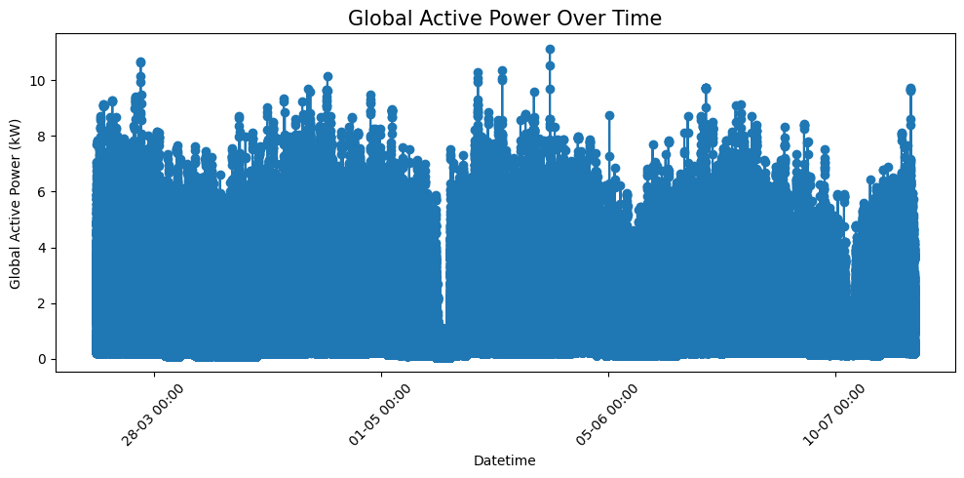
See the Story
Plot representation to visualize the data in an effective way.
Line Graph:
Observation :
.There are fluctuations in power usage, with several peaks reaching above 10 kW.
. The power usage appears to have periodic increases and decreases, which could be due to daily or weekly consumption patterns.

Slide 7
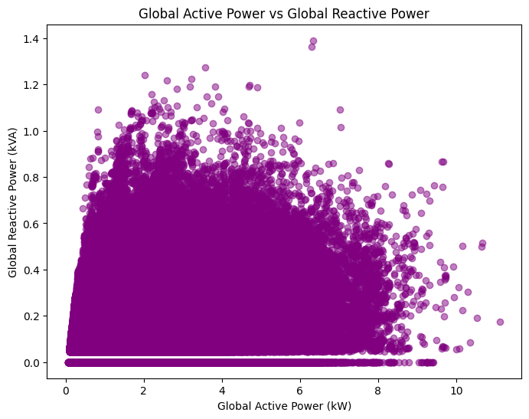
Scatter Plot :
To explore the correlation between Global Active Power and Global Reactive Power, which help understand power efficiency.
Observation
The data points show a clear triangular pattern, with most values concentrated between 0 to 6 kW for active power and 0 to 0.8 kwh for reactive power.
. There are some points where the reactive power spikes independently of active power.

Slide 8
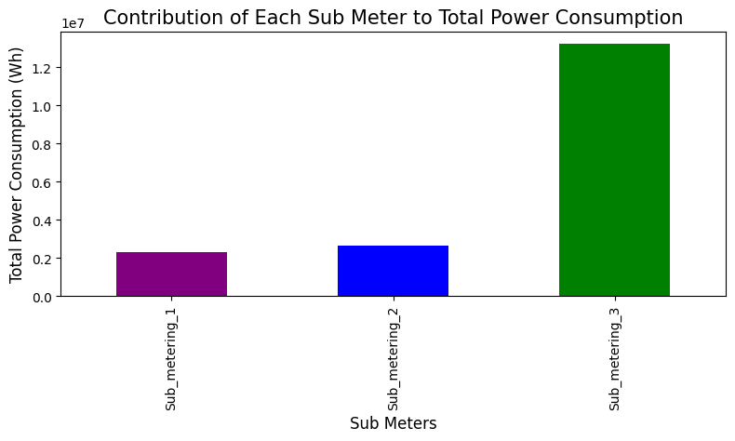
Bar Chart : Here this bar chart visualizes the relative contribution of each sub-meter to the total consumption.
Observation
-> Here in the below plot the Sub Metering 3 has high power consumption.

Slide 9
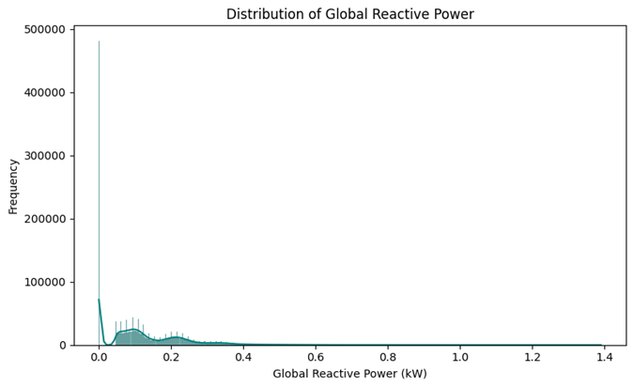
Histogram : A histogram shows the distribution of Global reactive power , revealing typical values and any skew ness.
Observation
-> The distribution of Global Reactive Power is highly skewed to the right, with most values concentrated at the low end.
->This positive skew ness indicates that the system generally consumes low reactive power, suggesting efficient power usage.

Slide 10
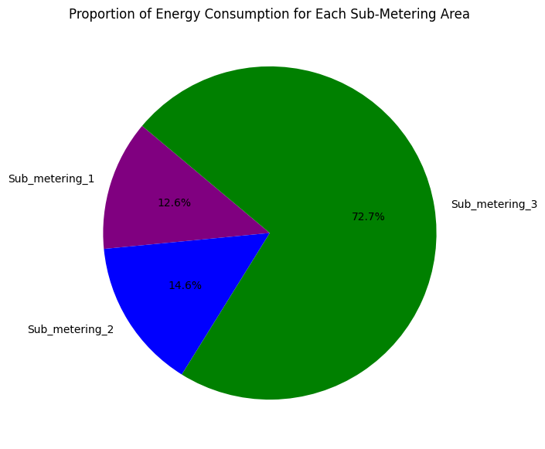
Pie Chart : Easily see the percentage of total power consumption attributed to each sub-meter.
-> This can help identify which areas or devices consume the most power.
Observation
->Here the sub metering _3 have the highest percentage of Energy Consumption among all the Sub metering areas.

Slide 11
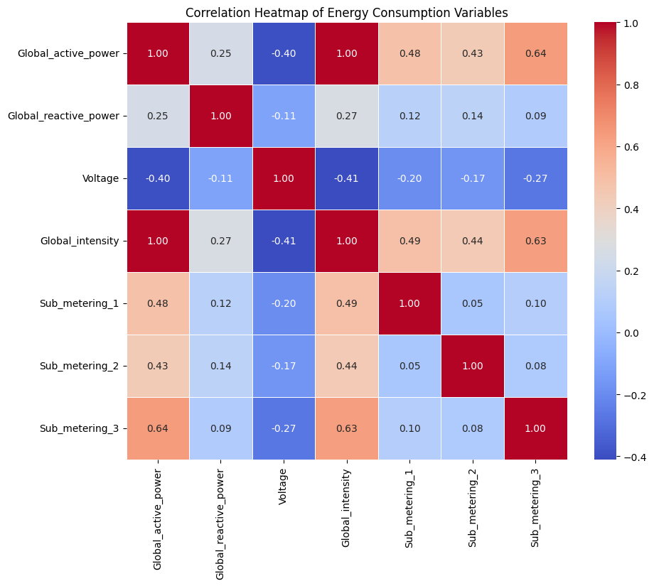
Heat Map : Here this heat map will display the correlation values between each pair of variables, ranging from -1 (strong negative correlation) to +1 (strong positive correlation).
-> Values close to 0 indicate little to no linear relationship.

Slide 12
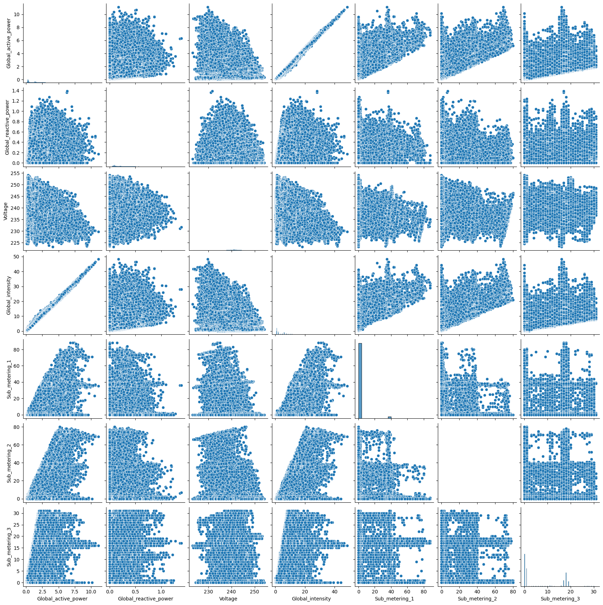
Pair plot : help us understand how these energy-related metrics are related to each other.

Slide 13
Smart Features
Data encoding is the process of converting categorical data into a numerical format so that it can be effectively used by machine learning algorithms.
we convert data to the proper type to perform the future prediction.
Year
Month
Day
Date and Time columns
Hours
Minutes

Slide 14
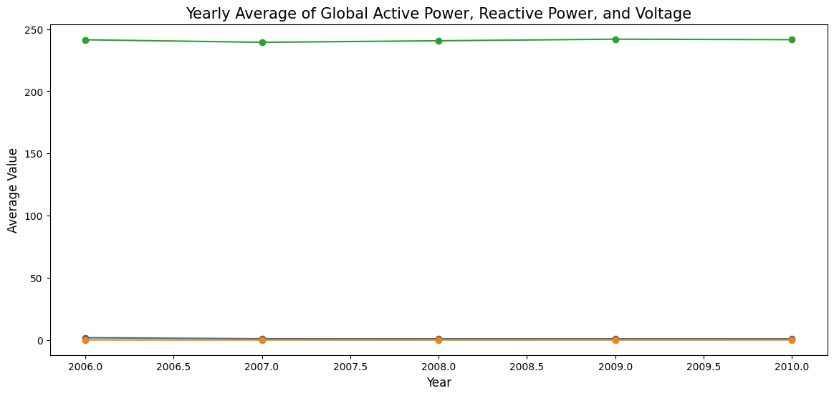
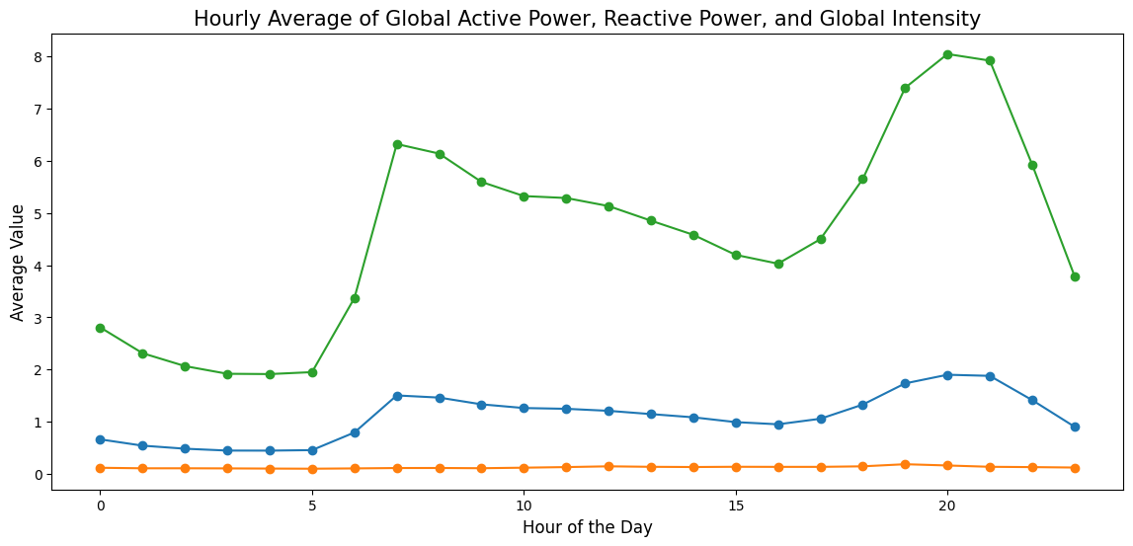
Visualize on the encoded data
Green –Voltage Orange – GRP Blue - GAP

Slide 15
Check whether the day is a holiday or not .
Find if there is sunlight during the time given in the dataset .
(0 = not holiday)
(1=holiday)
(0600-1800 hours -1 (light )else(0)

Slide 16
Predictions using Machine Learning Models:

Slide 17
Basic ML Models :
Linear Regression
Lasso Regression
Ridge Regression

Slide 18

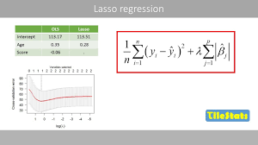
Linear Regression Lasso Regression

Slide 19
Steps to Implement the ML Models
Select the feature and target columns.
Decide the variables predict (target), such as Global active power
choose the predictors (features), such as Voltage, Global intensity, etc.
Split the data into training and testing sets.
Use a regression model to train on the dataset.
Evaluate the model's accuracy by using Mean Squared Error (MSE) or R-squared.

Slide 20
Compare the Machine Learning Models

Slide 21
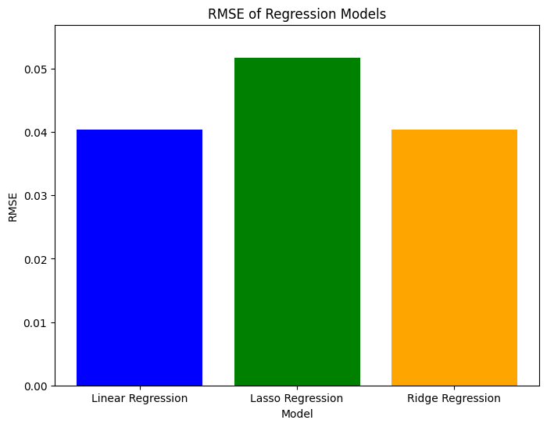
Graphs

Slide 22
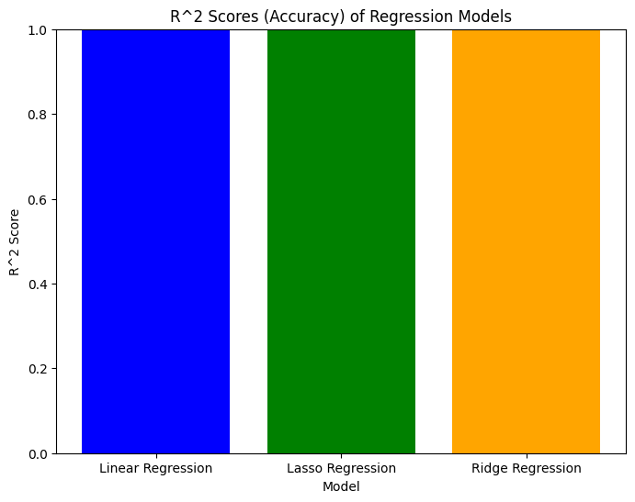
Linear Regression (Blue): Achieved an R 2 score of 1.0 and the lowest RMSE, indicating a very strong fit and high accuracy in terms of predictions.
Ridge Regression (Green): Also had an R 2 score of 1.0 with a slightly higher RMSE than Linear Regression, indicating that while it still explains all variance in the data.
Lasso Regression (Orange): Also achieved an R 2 score of 1.0 but had the highest RMSE, suggesting it might not be the best model for this dataset since its predictions are less accurate compared to the other two models.

Slide 23
MODEL ANALYSIS

Slide 24


Slide 25
ARIMA (Auto regression Integrated Moving Average) :
ARIMA is a powerful statistical modeling technique used for time series analysis and forecasting.
It combines three main components:
Auto Regressive (AR), Integrated (I), and Moving Average (MA), which are configured through parameters p, d , and q respectively.
Components of ARIMA
Auto Regressive (AR) Component
Integrated (I) Component
Moving Average (MA) Component

Slide 26
Combined Model: ARIMA(p , d , q)
The complete ARIMA model is a combination of the AR, I, and MA components:
𝑌 𝑡 = 𝜇 + ( 1 + 𝜃 1 𝐿 + 𝜃 2 𝐿 2 + ⋯ + 𝜃 𝑞 𝐿 𝑞 ) 𝜖 𝑡
Expresses,
𝑌 𝑡 as:
AR Part: Depends on past values ( 𝑝 ).
Differencing Part: Accounts for trend ( 𝑑 ).
MA Part: Adjusts for past errors ( 𝑞 ).

Slide 27
Steps involve in ARIMA Model
Install stasmodels and import ARIMA .
Check for stationarity.
Determine AR, MA Orders ( 𝑝 , 𝑞 )
Autocorrelation Function (ACF) Plots.(q)
Partial Autocorrelation Function (PACF) Plots.(p)
Fit the ARIMA Model
Evaluate Model Fit
Forecast
Use the model to predict future values and assess forecast accuracy with RMSE (Root Mean Squared Error).

Slide 28
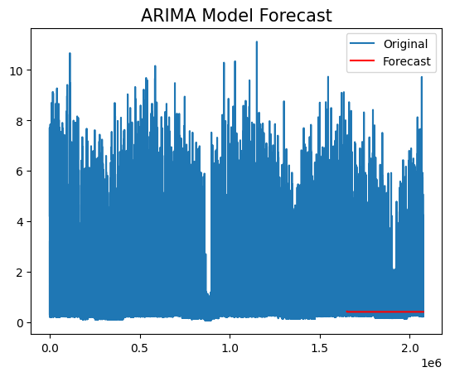
Graph

Slide 29
Observation:
The plot shows the ARIMA Model Forecast and its comparison to the original time series data.
Original (Blue Line):
The blue line represents the actual observed data over time.
There is a significant amount of fluctuation in the data, with noticeable spikes.
Forecast (Red Line):
The red line represents the ARIMA model's predicted values for the test period.
The forecast appears nearly constant or flat, failing to capture the variations or trends present in the original data.
Model Performance:
The ARIMA model does not seem to adequately represent the underlying pattern of the data.
It might have predicted a flat trend because:
The model could be under fitting the data.
The model parameters ( 𝑝 , 𝑑 , 𝑞 ) may not be optimal.
High Variability in the Original Data:
The original data exhibits significant spikes and variability.
Short Forecast Range:
The red line only appears toward the end of the timeline, likely indicating a short forecast.

Slide 30
Prophet Model:
The Prophet model is a time series forecasting tool designed by Facebook to be simple, flexible, and effective, especially for data with strong seasonal patterns.
The Prophet model assumes that a time series can be represented as:
y(t) = 𝑔 ( 𝑡 ) + 𝑠 ( 𝑡 ) + ℎ ( 𝑡 ) + 𝜖 𝑡
Where:
y(t): The observed value at time t.
g(t): The trend function that models long-term growth or decline.
s(t): The seasonality function that models repeating patterns (e.g., daily, weekly, yearly).
h(t): The effect of holidays or special events.
𝜖 𝑡 : The error term (random noise).

Slide 31
Steps involve in Prophet Model
Install prophet and import Prophet.
Splits the dataset into training and testing sets.
Trains the Prophet model on the training data.
Creates future timestamps for 7 days and 30 days beyond the training period.
Generates predictions for these future periods, capturing the point forecast.

Slide 32
Visualize Prophet Model
Trend: Captures the overall upward or downward movement.
Seasonality: Captures regular patterns like "weekends have lower power consumption."
Holiday: Captures special deviations.

Slide 33
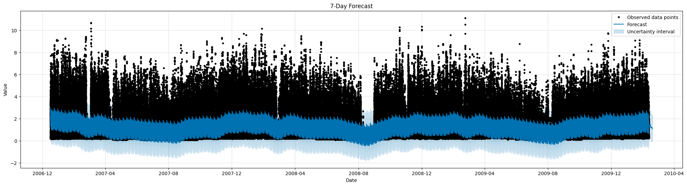
Visualize Forecast for 7days:

Slide 34
Observations
Observed Data Points (Black Dots):
->These are the actual values from the dataset plotted over time.
->They show significant variability and spikes, indicating fluctuations in energy consumption.
Forecast (Blue Line):
->This line represents the predicted values generated by the Prophet model.
->It captures the overall trend and periodic behavior in the data.
(Shaded Blue Area):
->In this graph, the uncertainty range is relatively consistent for most of the period but widens slightly toward the edges, which is for forecasted values beyond the training range.

Slide 35
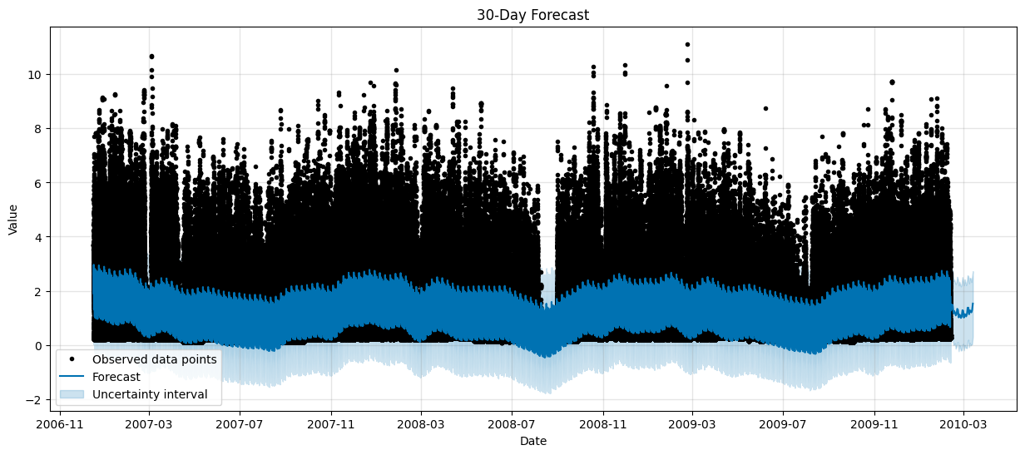
Visualize Forecast for 30days:

Slide 36
Observation:
The plot shows the 30-Day Forecast generated using the Prophet model.
Forecast Trends:
The forecast aligns with the general behavior of the observed data, capturing the trend and periodicity.
However, extreme spikes in the data are not modeled, as Prophet tends to smooth out noise to focus on trends and seasonality.
Uncertainty:
The uncertainty band is relatively narrow in the observed data range but widens slightly in the forecasted region, which is expected in time series forecasting models.
Seasonality and Trend:
The model seems to identify recurring patterns and trends in the data, which is characteristic of Prophet model to decompose time series into trend, seasonality, and holiday effects.

Slide 37
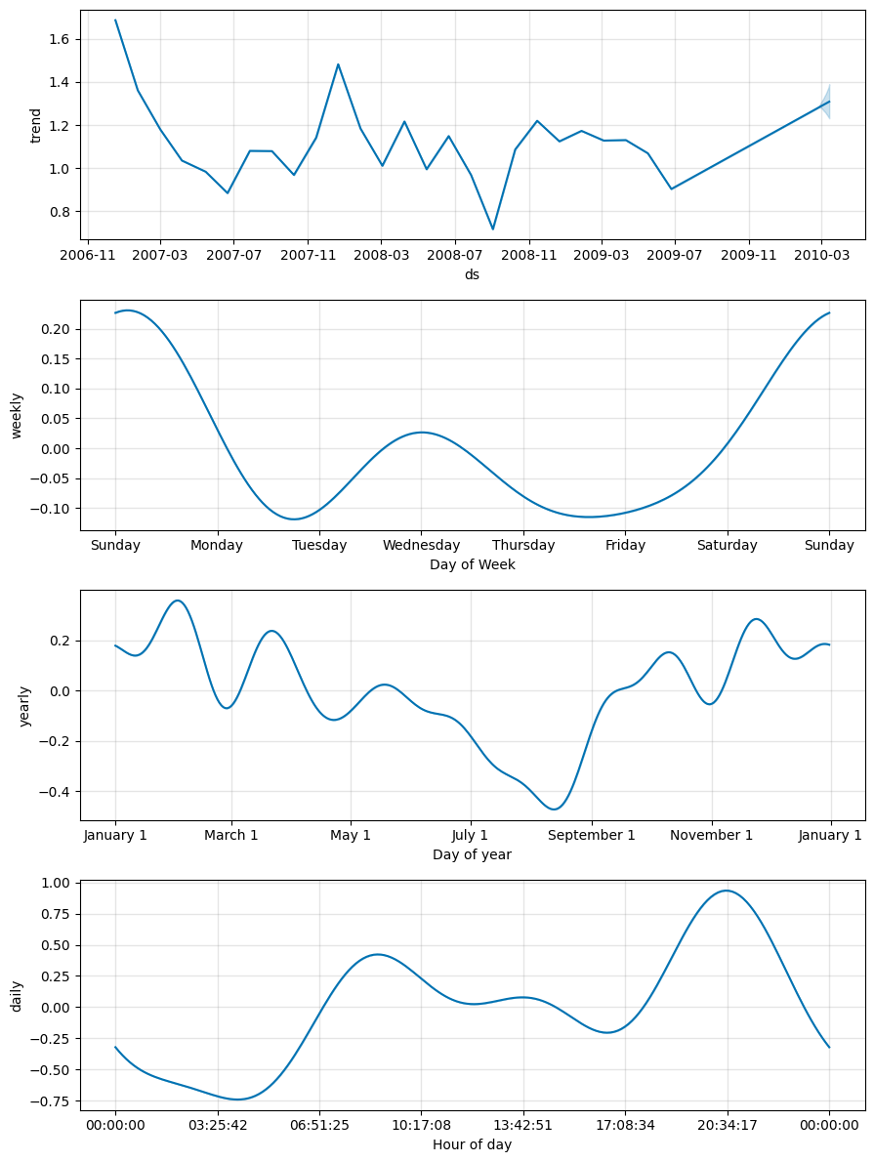
Components Analysis:
30_days
Observations
Trend Component
Weekly Seasonality
Yearly Seasonality
Daily Seasonality

Slide 38
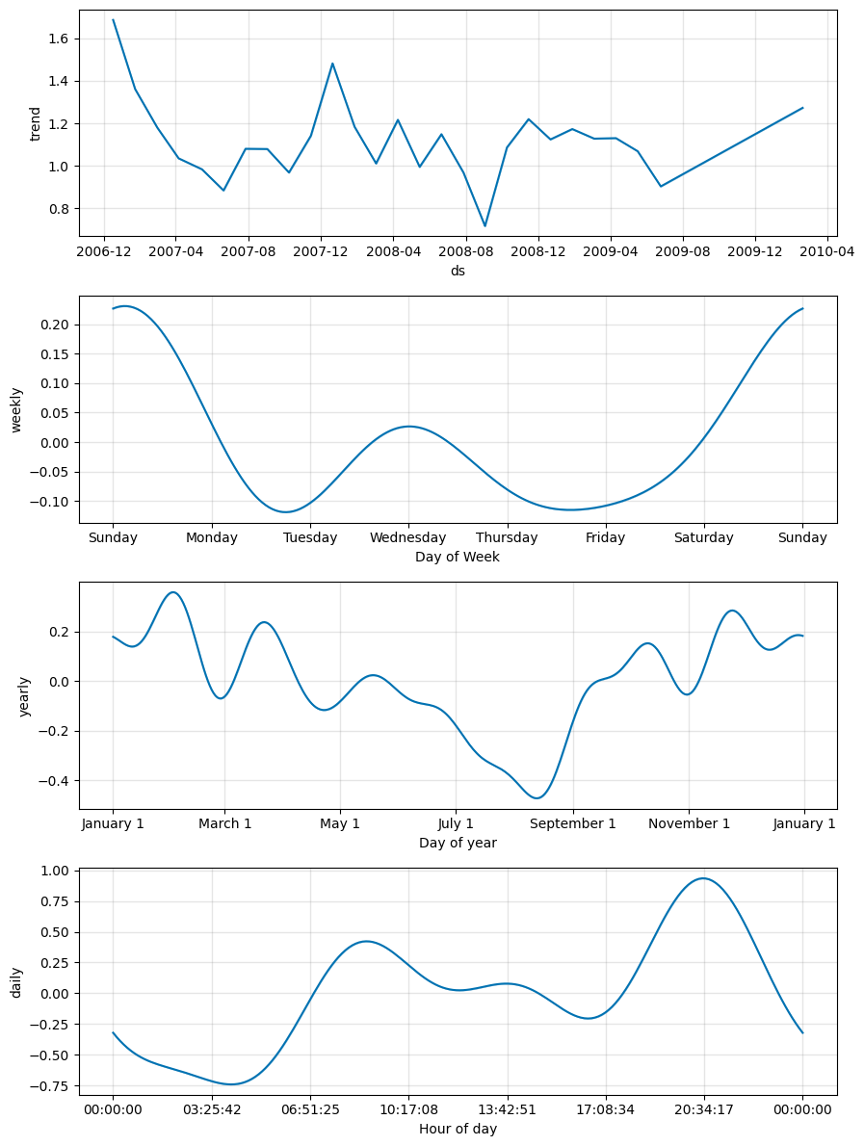
7_days
Observations
Trend Component
Weekly Seasonality
Yearly Seasonality
Daily Seasonality

Slide 39
Prophet v/s ARIMA: Choosing the Right Model for Energy Forecasting"

Slide 40
The Prophet forecast accounts for trend, weekly seasonality, yearly seasonality, and daily seasonality. The decomposition charts show these clearly.
The Prophet forecast adjusts to variations in energy consumption (e.g., weekends, holidays, and daily patterns),
The forecast in the ARIMA graph shows a flat trend in the future indicating limited sensitivity to changes or seasonality.
ARIMA is less effective at capturing long-term seasonality

Slide 41
Wrap up:
"Final Verdict on Forecasting Models"

Slide 42
Adopt Prophet as the primary model for energy consumption forecasting,
with ARIMA as a supplementary tool for very short-term accuracy or highly stationary periods.
Use ARIMA for short-term predictions (e.g., next few hours or days).
Use Prophet for medium to long-term predictions (e.g., weekly, monthly, yearly),

Slide 43


